Slide 1

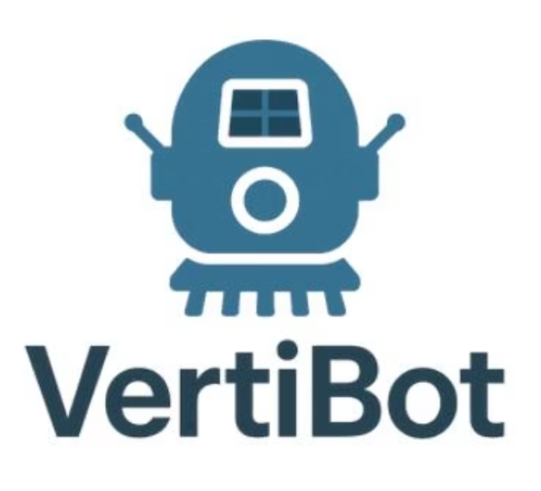

VERTIBOT: Climb Smart. Clean Safe.
Revolutionizing glass facade cleaning for corporate buildings with an innovative, safe, and cost-effective robotic solution.

Slide 2


Problem Statement
High Risk
High Cost
Inefficient
Office buildings with large glass facades require regular cleaning using dangerous manual labor and scaffolding systems.
Companies spend ₹20,000 – ₹50,000 per cleaning every few months depending on glass size.
Current scaffolding systems are time-consuming and create significant operational disruptions.

Slide 3

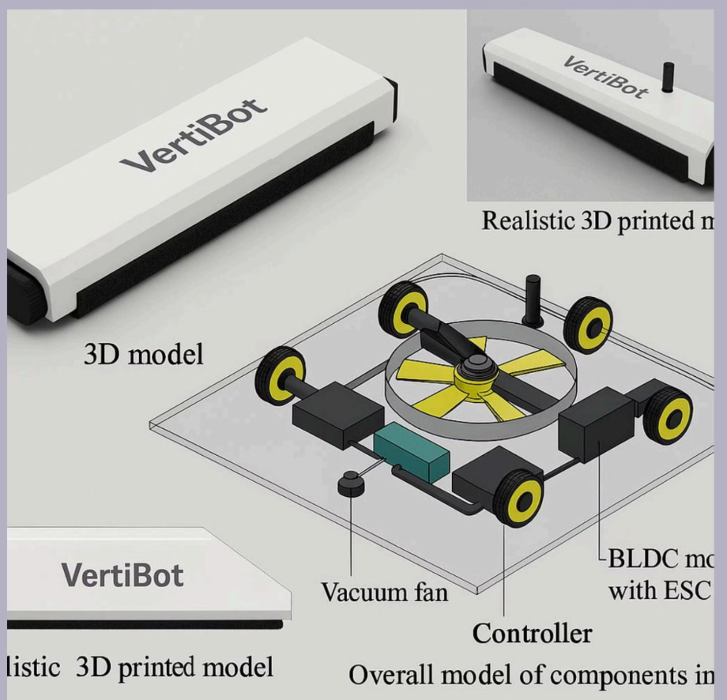
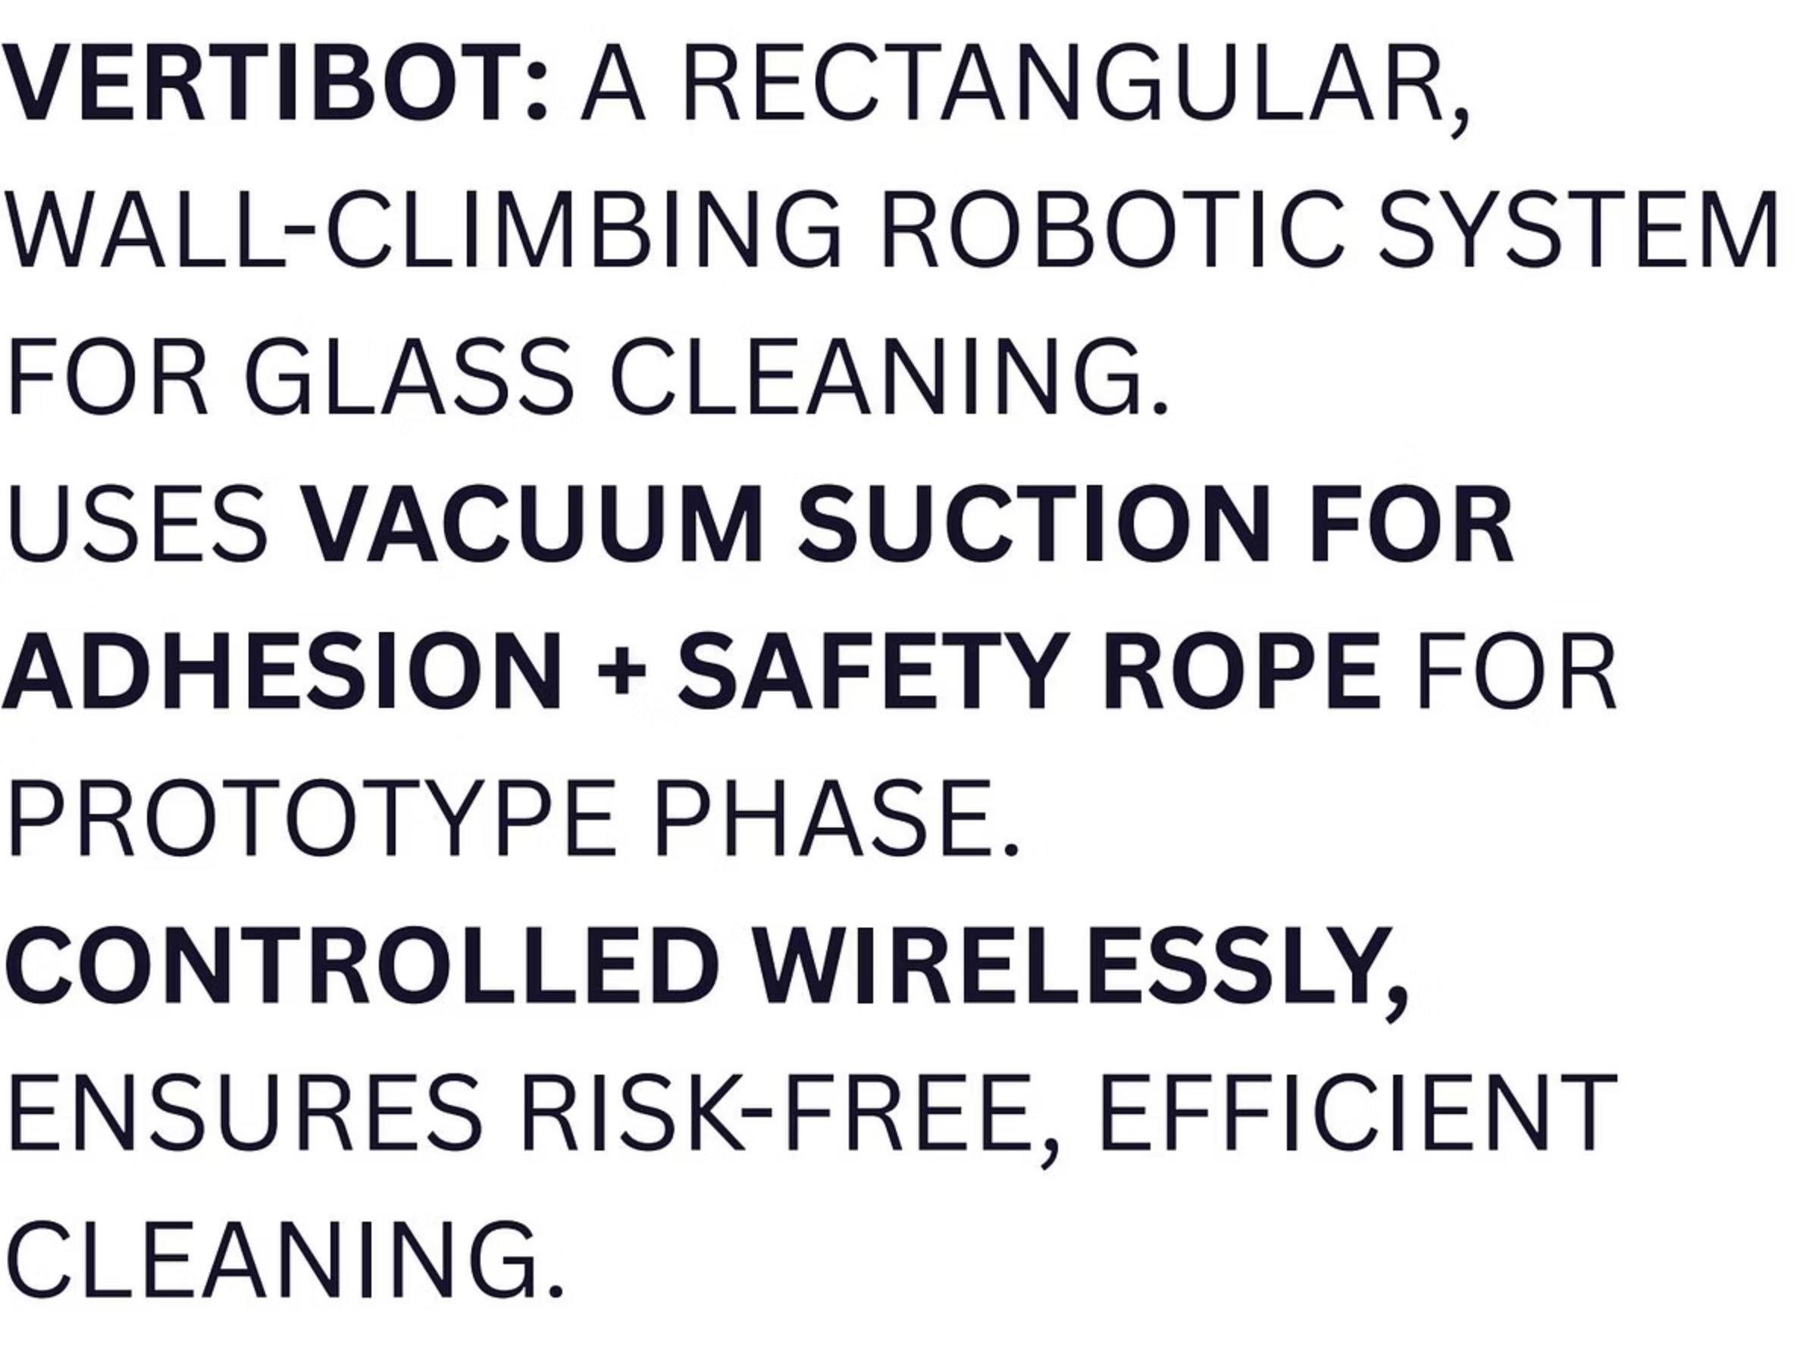
Our Innovative Solution
VERTIBOT is a specialized cleaning robot designed to safely and efficiently clean glass facades on high-rise buildings without the risks and costs associated with traditional methods.
Our solution eliminates the need for dangerous manual cleaning while providing faster, more cost-effective results for corporate clients.

Slide 4
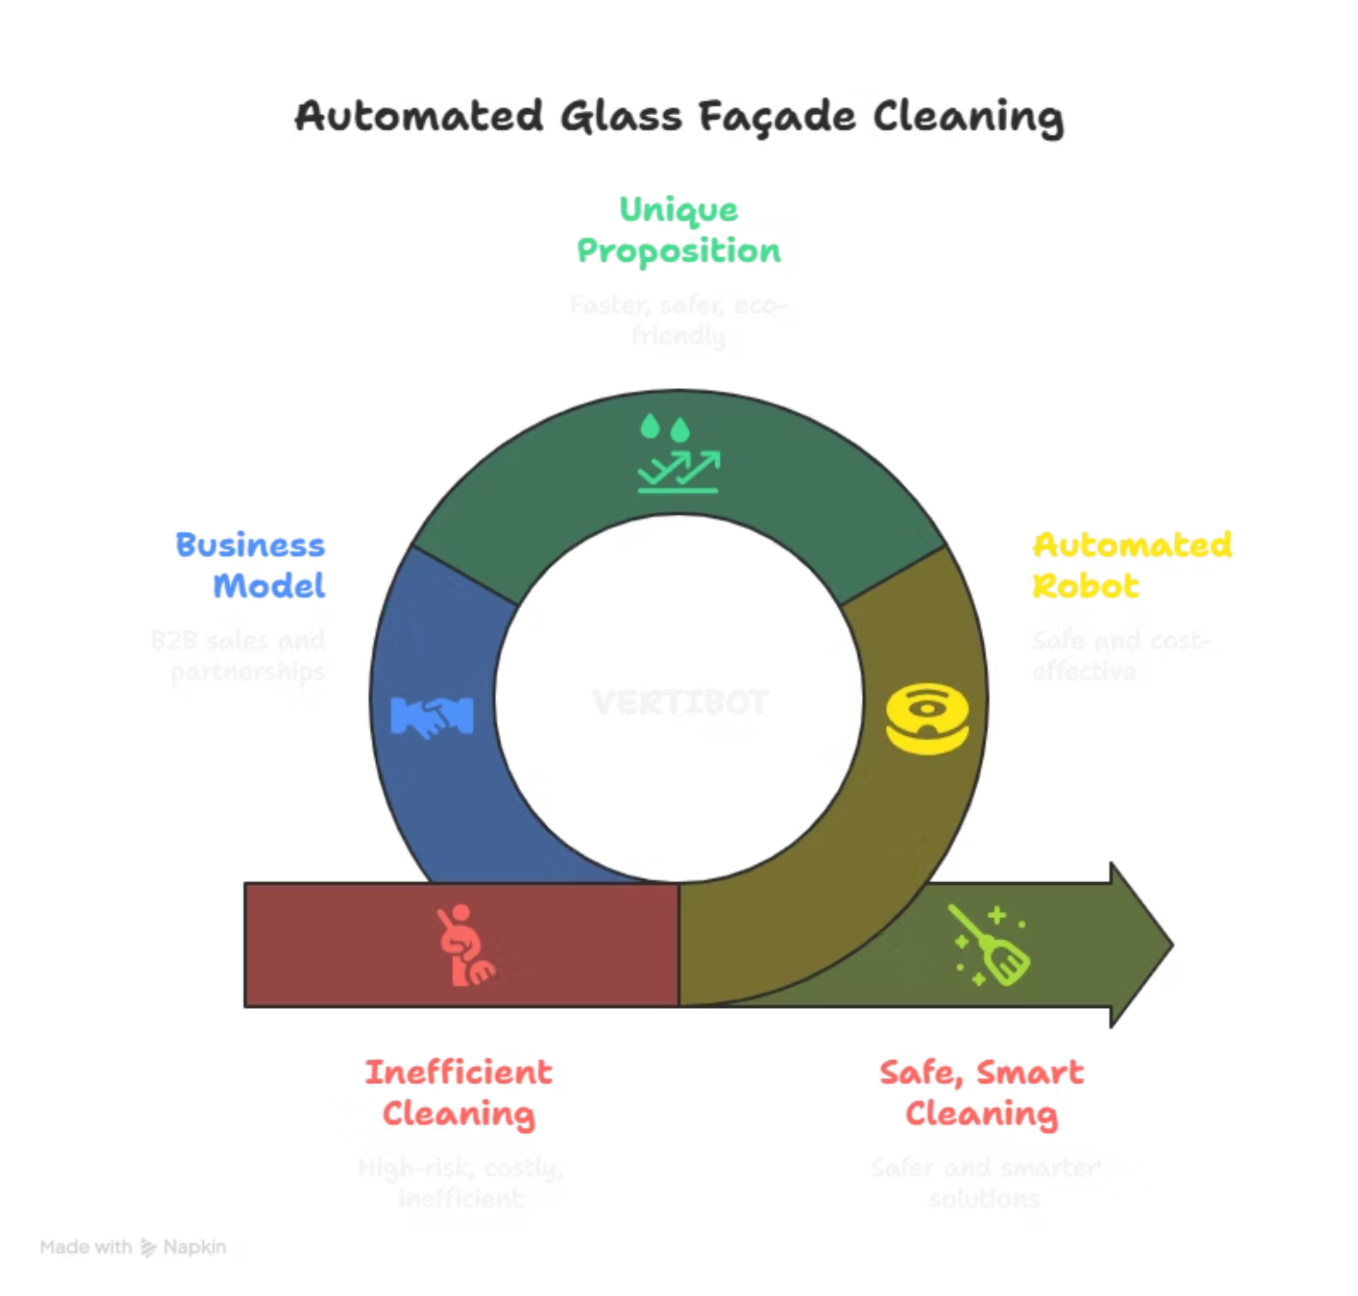
FLOWCHART

Slide 5
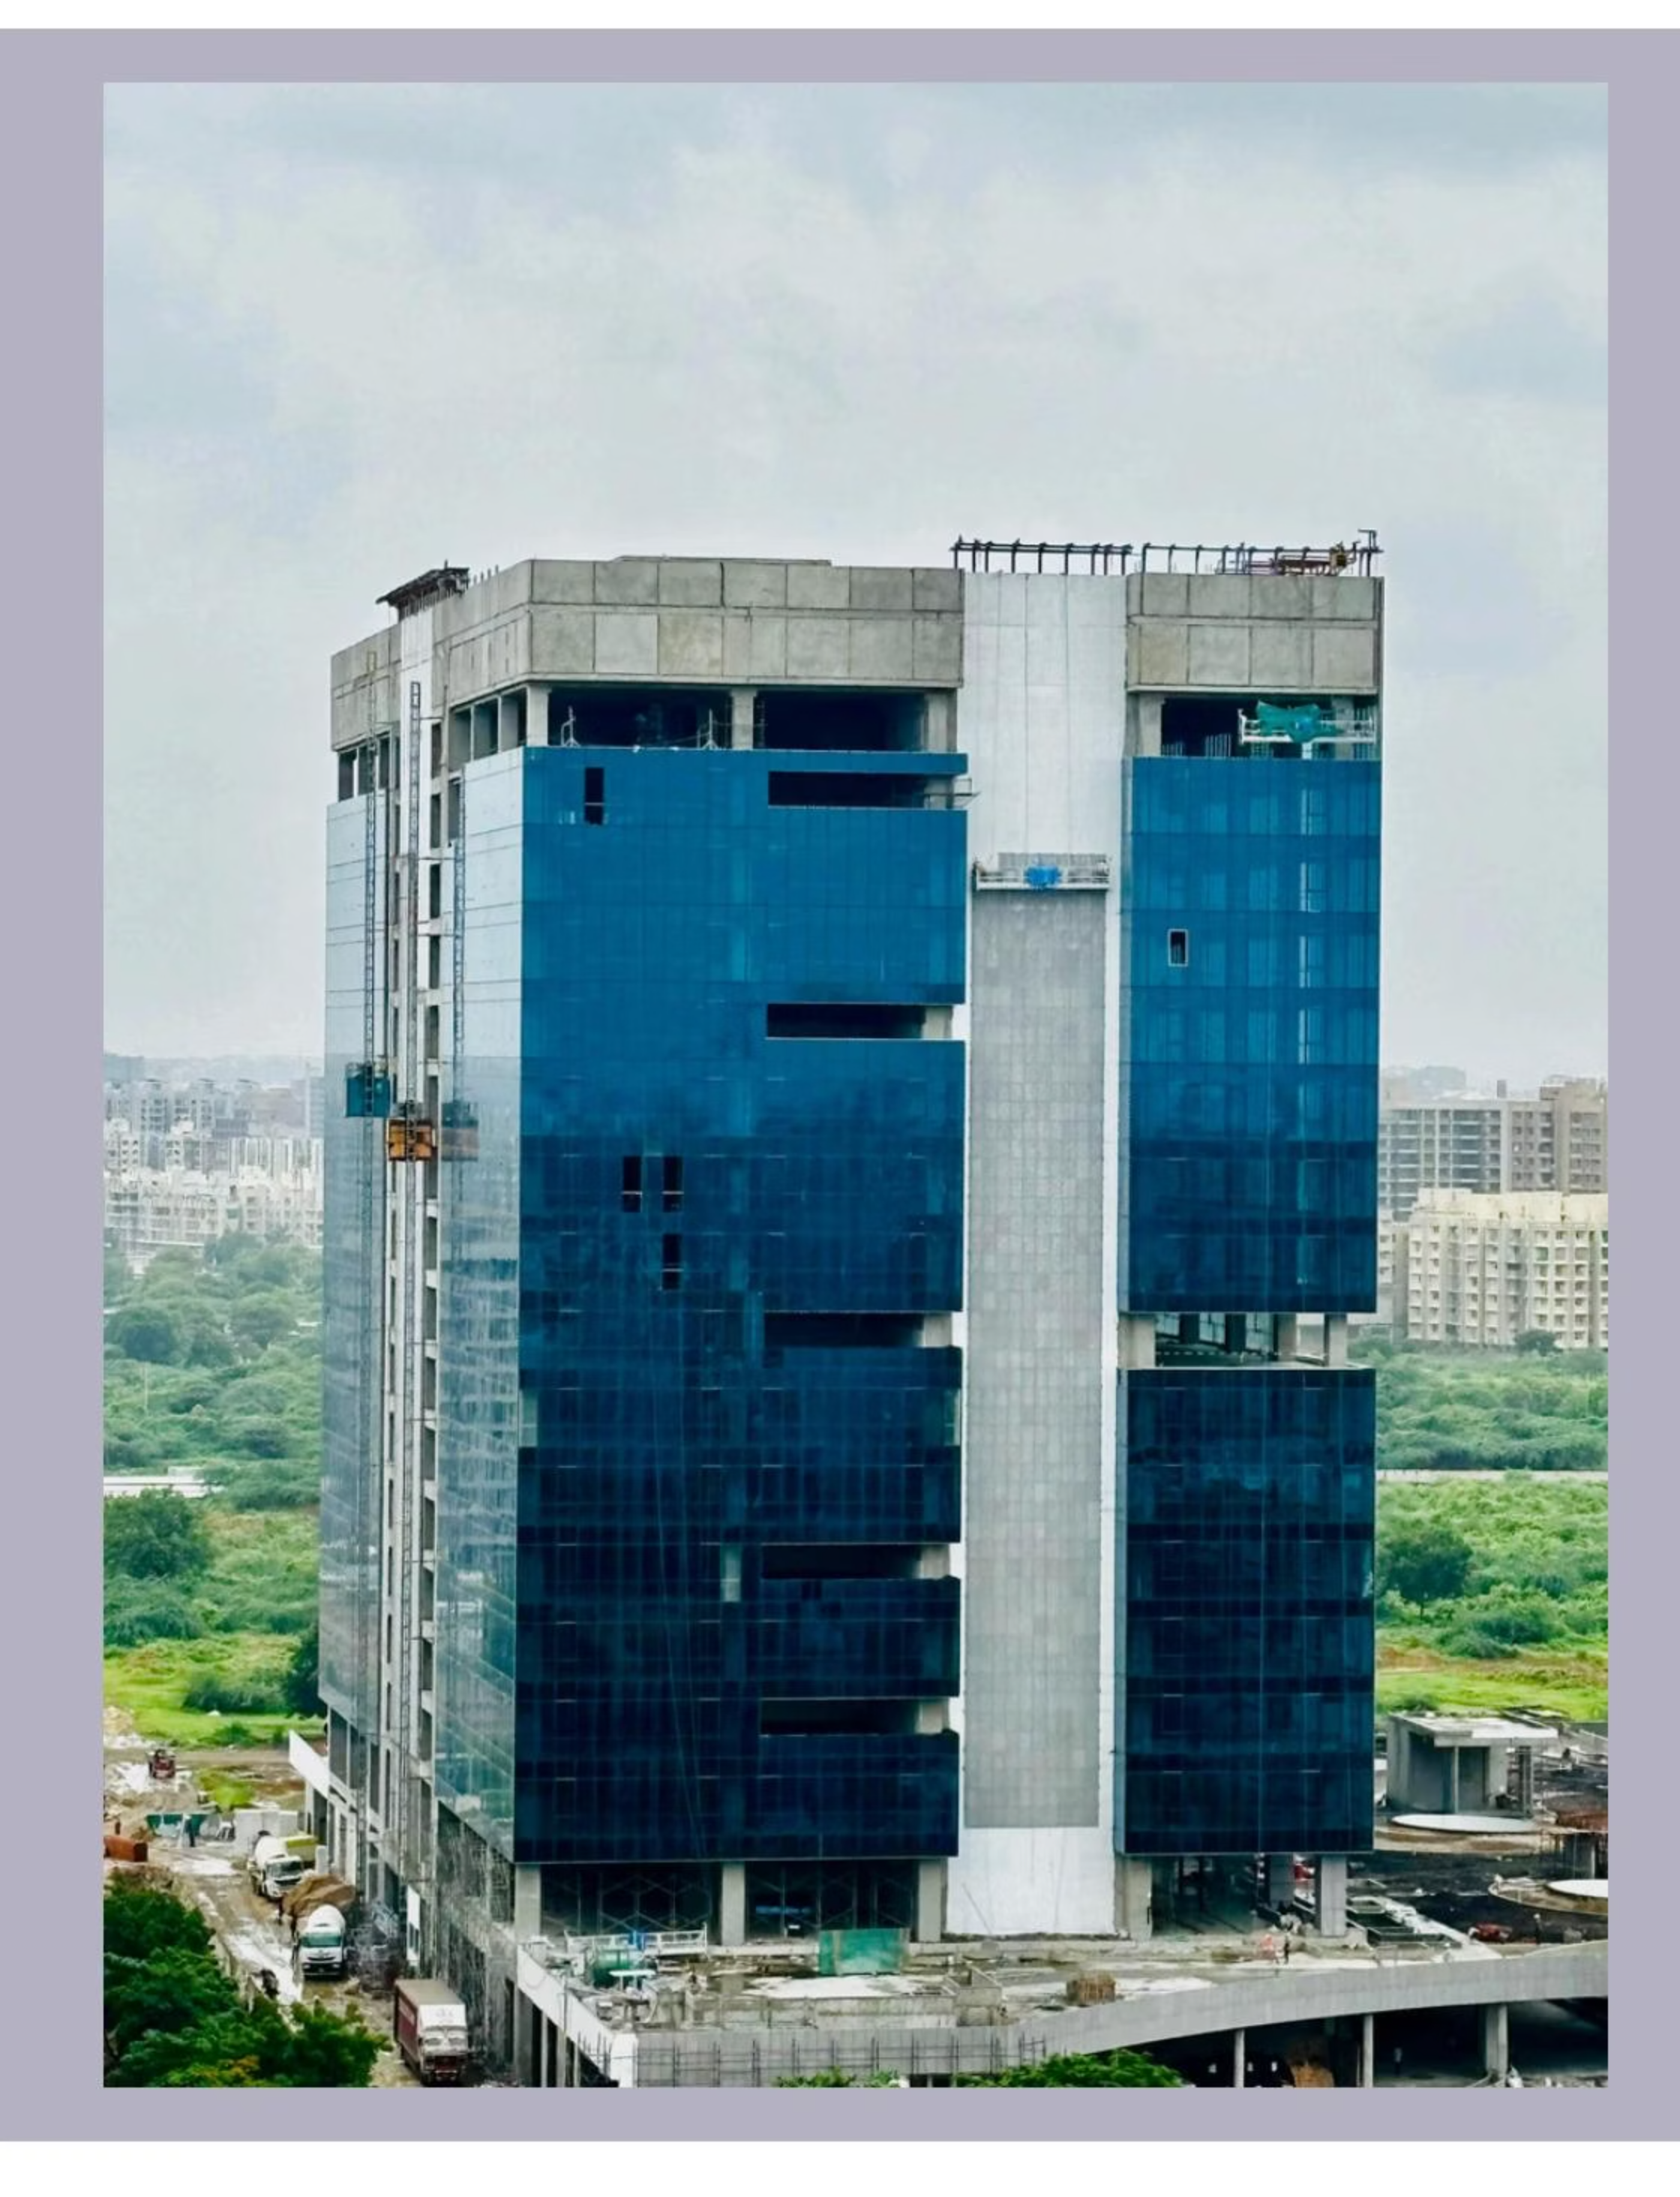
Today's Agenda
01
02
Problem Statement
Our Innovative Solution
Understanding the challenges of traditional glass facade cleaning
Introducing VERTIBOT and its capabilities
03
04
Our USP
Market Analysis
What makes VERTIBOT unique in the market
Survey results, SWOT analysis, and market opportunities
05
06
Business Model
Meet The Team
BMC, financial model, and pricing strategy
The innovators behind VERTIBOT

Slide 6


Our Unique Selling Proposition
Faster & Safer
VERTIBOT provides significantly faster and safer cleaning than traditional manual methods, eliminating human risk.
Affordable Alternative
Our solution offers a cost-effective alternative to large scaffolding systems and high labor costs.
Specialized Design
Created specifically for corporate glass facades with features tailored to this unique application.
Eco-Friendly
Solar-powered operation reduces environmental impact and operational costs.

Slide 7
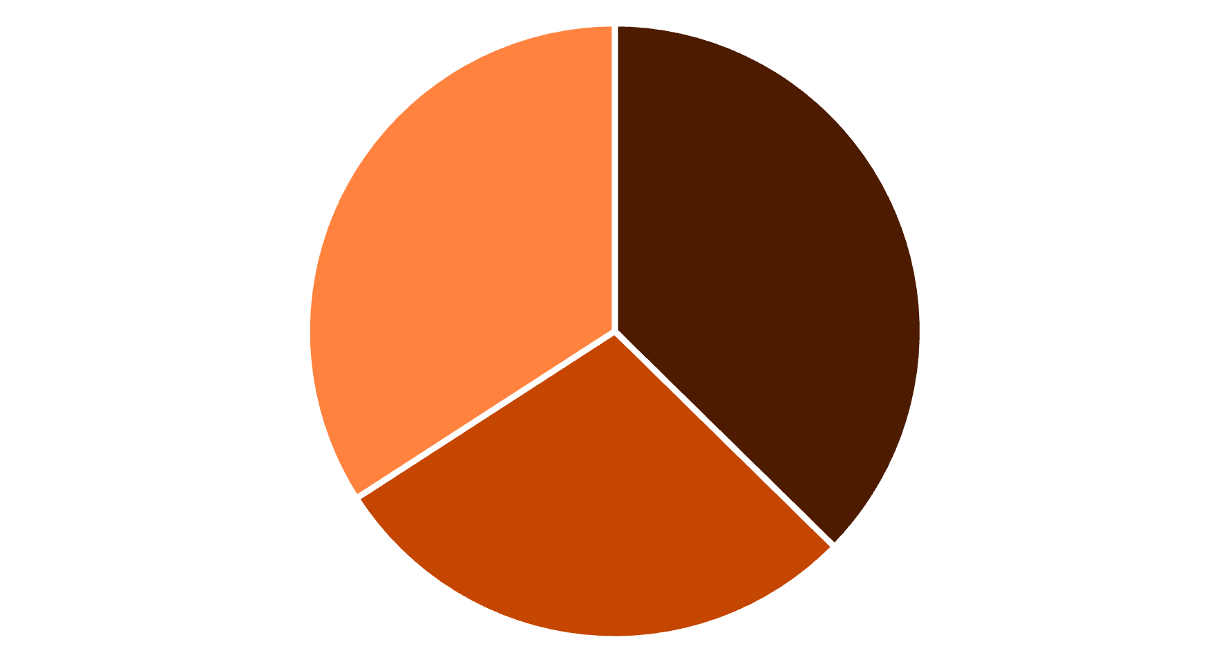
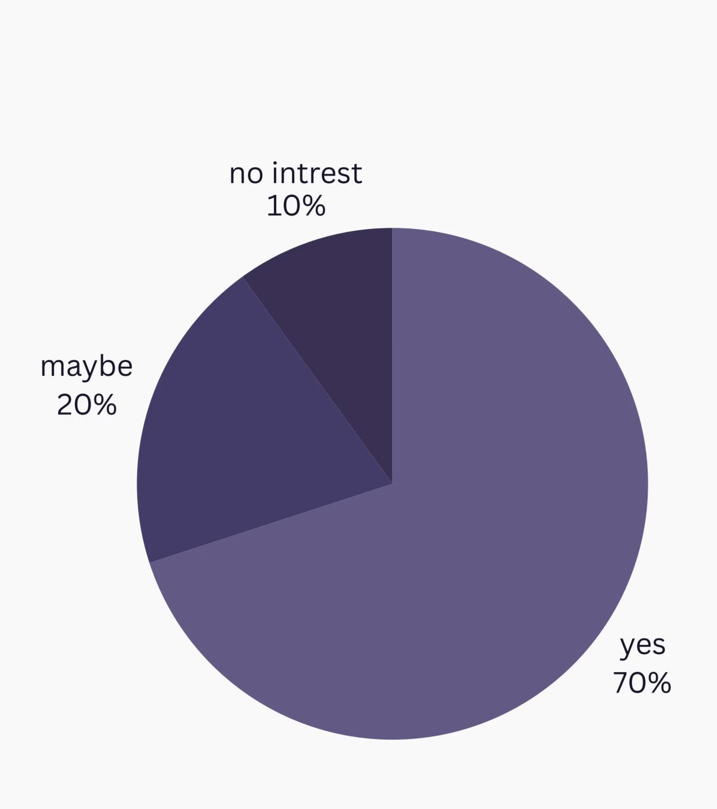
Survey Analysis
93% of offices face difficulty cleaning high surfaces
71% delayed cleaning due to risk & effort
Strong interest in automation solutions
Offices consistently demand risk-free, efficient cleaning solutions that minimize operational disruptions
Difficulty cleaning high su...
Delayed cleaning due to risk
Interest in automation

Slide 8
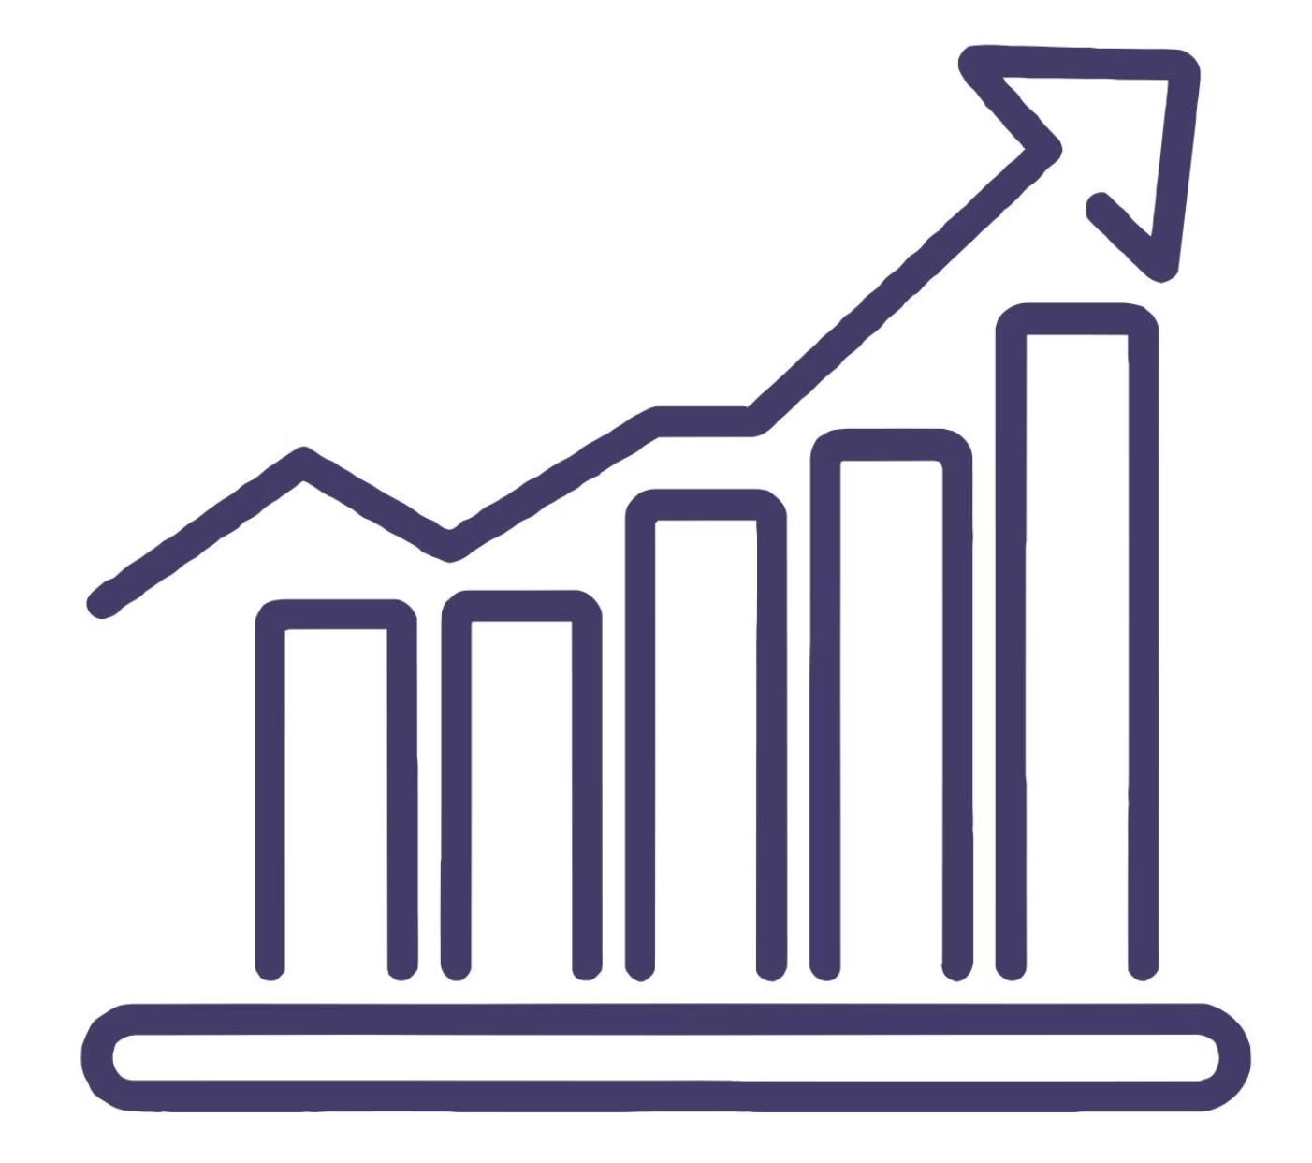
Market Opportunities
India's cleaning services market: ₹5,000 CR+, growing rapidly
10,000+ high-rise buildings with glass exteriors just in Mumbai, Delhi and Bangalore
Significant lack of automated façade cleaning solutions in India
Target Customers:
Corporate offices
Malls
Hotels
IT parks

Slide 9

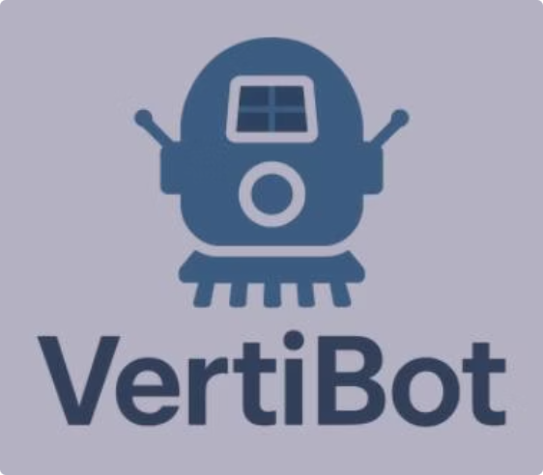
Business Model Canvas & Financial Model
Business Model Canvas
Financial Model
Value Proposition: Safe, automated, cost-effective glass cleaning
Prototype Cost (Phase 1): ₹12,000–₹15,000
Channels: Direct B2B sales, partnerships with cleaning companies
4 DC Motors: ₹800
Revenue: Sale of robot + AMC (Annual Maintenance Contract)
1 BLDC Motor + ESC: ₹1,000
Key Activities: Design, manufacturing, service
Transmitter & Receiver: ₹5,000
Key Partners: Hardware suppliers, cleaning service firms
Frame, Wiring, Suction System: ₹5,000
Service Pricing: ₹10–15 per sq. ft. (cheaper than manual scaffolding)
Long-term: Leasing or Robot-as-a-Service model

Slide 10




Meet The Team
Rishika Bhagtani
Anany Kelotra
Aaditya Jain
Heer Kasturi
Yash Gangtani
Thank you for your time and attention - Team VERTIBOT

